Slide 1
1920’s
From Boom To Bust

Slide 2
Prohibition
.EFFECT:
Speakeasies: illegal, underground bars
Rise in drinking rate
Increase in organized crime ( Gangsters)
Rise in murder rate in cities
LAW:
Banned the sale and consumption of alcohol
18th Amendment (1920)
21st Amendment (1933)

Slide 3
What is Jazz?
. Duke Ellington: Cotton Club
HARLEM RENAISSANCE:
HARLEM: promised land
Hot bed of political, social and cultural activity in 1920’S
Harlem was “end of line” to African Americans
Jazz:
Lively music, rhythmic beats
Celebration of African American culture, heritage and tradition

Slide 4
Warren G. Harding Promises “Return To Normalcy”
Republican Party returns to power with presidency of Warren G. Harding.
World War I vets return home looking for jobs; economic recession as factories in rural America close
Harding’s “return to normalcy” appealed to all Americans as they yearned to forget the war and return to life as it was before the horrors of World War I.
Change centers in cities as many move to cities looking for jobs and prosperity

Slide 5
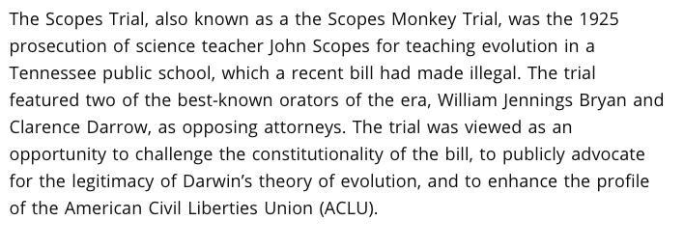
SCOPES MONKEY TRIAL DAYTON, TENNESSEE 1925

Slide 6
Warren G. Harding White House Scandals
Looking wan and depressed, Harding journeyed westward in the summer of 1923, taking with him his upright Secretary of Commerce, Herbert Hoover.
"If you knew of a great scandal in our administration," he asked Hoover, "would you for the good of the country and the party expose it publicly or would you bury it?”
Hoover urged publishing it, but Harding feared the political repercussions.

Slide 7
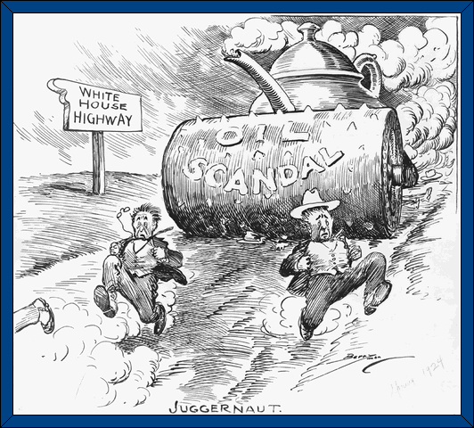
Document Analysis:
S¹ ⁺ SB² + DPM = Enduring Issue
Juggernaut: huge, powerful overwhelming force
Source: Clifford Berryman's, Pulitzer Prize Winning cartoonist,. Library of Congress. 1924.

Slide 8
Warren G. Harding White House Scandals
Ohio Gang- Harding hires his friends from Ohio for political positions; they abuse their power for personal gain
Teapot Dome Scandal- Secretary of the Interior Albert Fall takes illegal bribes from oil executives and illegally leases land in Teapot Dome, Wyoming. Fall becomes first public official to go to prison.

Slide 9
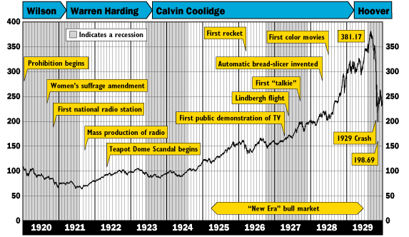
S¹ ⁺ SB² + DPM = Enduring Issue
SOURCE: Unknown S¹ ⁺ SB² + DPM = Enduring Issue

Slide 10
“Economic Prosperity?” Document 2
1. The economy went up as people bought consumer goods that were mass produced. Consumer confidence began to rise.
2. The average American was gainfully employed after the war. Jobs were up in cities, factories were cranking out consumer goods~ People were making lots of money, therefore people had “disposable” income (money to spend).
3. “buy now pay later”~ “Buying on Credit” or “Buying –on-the-Margin”(stocks) in the stock market.

Slide 11
“Ideological Change?” Document 2 (cont.)
3b. This effected consumer spending because consumers were spending more( in theory) because they could “get more”, through establishing a “line of credit”. They could literally “buy now” and pay for it “later” (at the end of the billing cycle).
3c. Buying on credit effected the overall economy by allowing it to grow and get better very fast. Consumer confidence was high and so they were comfortable with spending LOTS of money on whatever they wanted.

Slide 12
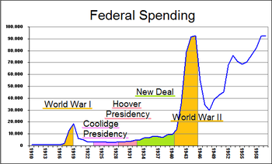
What is a recession?
A recession is an “economic depression” characterized by businesses slowing down, people losing their jobs, unemployment is high, fewer transactions are made, and spending dips downwards as people buy, sell, and trade less.

Slide 13
What is installment buying?
Installment buying is a system for purchasing a commodity over a period of time. The buyer gains the use of the commodity immediately and then pays for it in periodic payments called installments.
A commodity is an article of trade or commerce, especially a product as distinguished from a serve.

Slide 15
Buying Stocks –on –the-Margin
Buying on margin is most simply defined as borrowing money to buy securities (stocks, bonds and so on). Usually, the borrowed money comes from a broker. When investors buy stocks on margin, they take on additional risks because they are liable to pay their broker if the share price goes down. Usually, the investor buying on margin will also have to pay an interest rate on the borrowed money.

Slide 16
Buying Stocks –on –the-Margin
Buying stocks on margin is risky because the if the stock goes down, you are liable for both your losses and your broker's. For example, if you buy a stock on margin with $20 of your own money and $80 of your brokers and the stock goes down, you may be forced to sell some of your assets to repay the loan. This is called a margin call.
When buying stocks on margin, you will be charged interest. Money isn't free. Brokers charge interest on margin loans (usually between 6 and 10 percent).
The upside of buying stocks on margin is you have more leverage and if the share price goes up, you keep all the profit minus only the cost of borrowing the money.

Slide 17
Bull Market Economy
In securities and commodities trading, a rising market. A bull is an investor who expects prices to rise and, on this assumption, buys a security or commodity in hopes of reselling it later for a profit. A bullish market is one in which prices are expected to rise.

Slide 18
Kellogg-Briand Pact 1928
1. The U.S., Germany, Belgium, France, Great Britain, Ireland, Italy, Japan, Poland, The Czech. Republic …. 61 countries total signed this document.
2. The purpose of this document was renunciation (outlaw) of war; disarmament (countries reduce weapons and armed forces alike)
3. The big problem with this treaty was it outlawed war, but did not outline how to maintain peace.
One nation could still use force against another without fear of punishment.

Slide 19
Compelling Results:
Answer the following compelling question on the back of your packet.
Provide at least 2 pieces of from the on-line training packet slides, documents and your knowledge of social studies.
How did the United States create a period of economic prosperity, technologicial innovation and ideological change following our involvement in World War I?

