Slide 1
Mrs. Ingold’s Final Exam Review

Slide 2
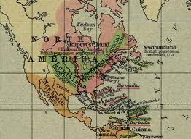
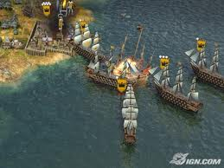
Section 1 and 2: Key Ideas

Slide 3
Major US Geographic Features
Major US Geographic features from East to West:
Atlantic Ocean, Appalachain Mts. Mississippi River, Great Plains Missouri River, Rocky Mountains and Pacific Ocean.
** All of these landforms were used throughout American History to help different groups of people survive.
In addition, they sometimes made life difficult:
BENEFIT: Isolation, protection, food, shelter, other basic necessities
DETRIMENT: Isolation, treacherous weather, dangerous crossings, other geographical dangers (cliffs, whirlpools, wild animals)

Slide 4
Archeology
PRIMARY SOURCES:
First hand accounts of historical happenings from people who were actually there – EX. diary entries, photographs, newspapers, interviews
SECONDARY SOURCES:
Historical analysis or interpretations of first hand accounts – EX. Textbooks, journals, books on varying topics
The study of past remains and making conclusions based on various artifacts

Slide 5
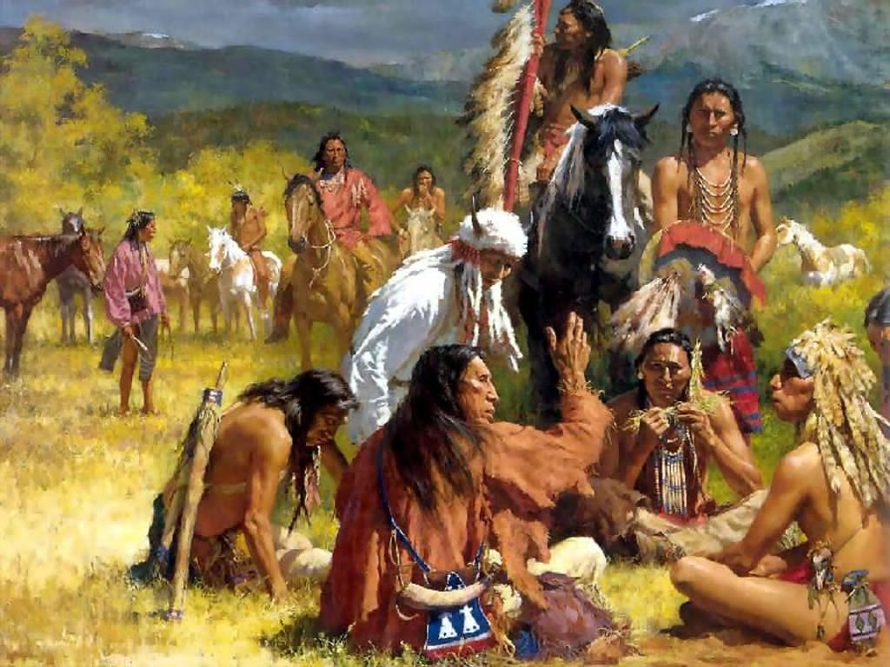
Native Americans
The first native people came across the land bridge from Asia (BERINGIA). They then moved south in search of food and warmer climates.
IROQUOIS: used their surroundings to make longhouses and clothing.
Developed the League of Nations/Iroquois Confederacy, which was a form of representative democracy with elected leaders

Slide 6
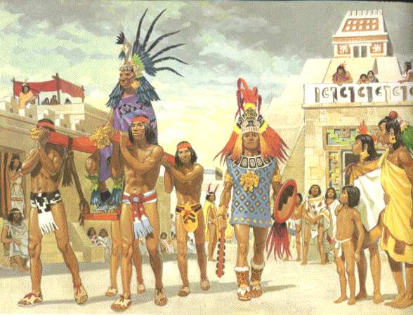
Mayans, Aztecs and Incas First American Civilizations
* All three used their surroundings
*All three were advanced
*All three mixed with Europeans
COLUMBIAN EXCHANGE: the exchange of diseases, ideas and technology between explorers/colonies and the Native Americans

Slide 7
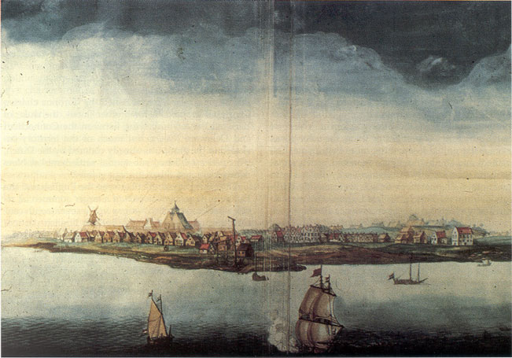
European Exploration and Colonization
DUTCH: Created New Netherland/New Amsterdam: later became New York City: Peter Stuyvesant was its leader. Located along the Hudson River Valley.
FRENCH: Colonies were in Canada, along the Mississippi River Valley and middle of future US and Haiti
New France used fur trading as a source of profit

Slide 8
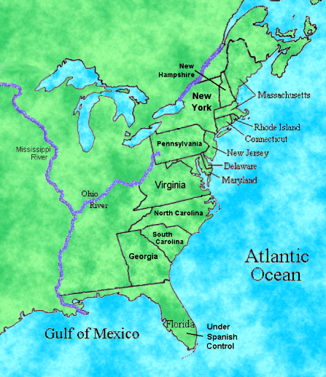
European Exploration and Colonization
SPANISH: Controlled Florida, sections of the western US, Central America, the Caribbean and sections of South America
ENGLISH: colonized sections of northern and southern Canada, and the 13 colonies of America. (Jamestown, VA was the first permanent settlement.

Slide 9
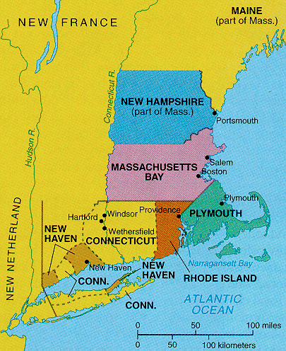
New England Colonies (Early 1600’s)
Pilgrims and Puritans come for religious freedom and set up very strict societies with many limitations
Mayflower Compact: created a system of laws and government for the new colonists. Written on the way over from Europe.
There was much interaction with the Native Americans and an exchange of ideas and cultures.

