Slide 1
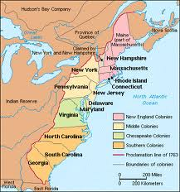
Section 3 and 4: The Colonies and New Government

Slide 2
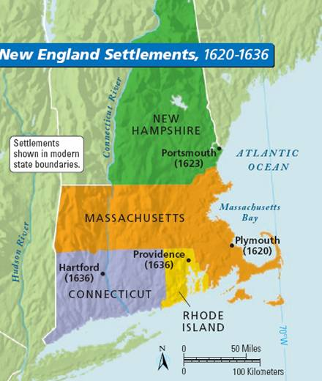
New England Colonies
Maine, New Hampshire, Massachusetts, Rhode Island, and Connecticut
FEATURES: Cooler climate
Short growing season
Rocky and hilly land
KEY INDUSTRIES:
Fishing, lumber, textiles, shipbuilding, whaling

Slide 3
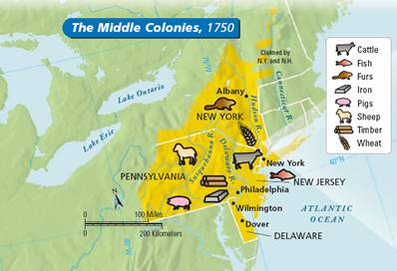
Middle Colonies
New York, New Jersey, Pennsylvania and Delaware
FEATURES: lots of access to water; “Bread Basket Colonies”
KEY INDUSTRIES:
agriculture, farming, lumbering, tobacco, rice, lumbering, ironworking

Slide 4
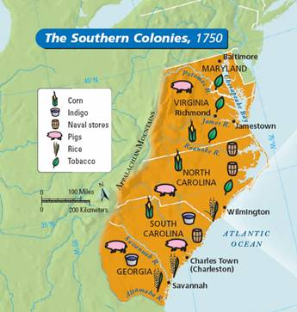
Southern Colonies
Chesapeake Colonies: Maryland, Virginia,
Southern Colonies: North Carolina, South Carolina, Georgia
FEATURES: Warmer Climate Long Growing Season
KEY FEATURES: Cotton and Tobacco major cash crops along with indigo, wheat, sugar, rice.
** Mostly slaves worked for the plantations

Slide 5
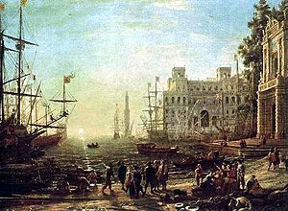
Early Colonial America Features
Most colonists tended to settle near rivers or other larger bodies of water for transportation, trade food and water supply.
Mercantilism: each colony exists for the benefit of the mother country (ex. Britain, France, Spain). Increases the mother country’s wealth and power
House of Burgesses: First elected legislative body of the New World in Virginia

Slide 6
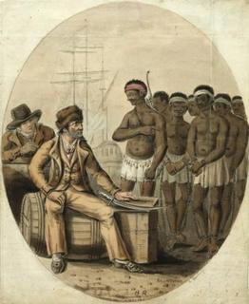
Slavery in the New World
Slaves were brought to the Americas to work the different farms and make money for each colonizing nation.
They were considered property from 1619-1865
The 13th Amendment abolished slavery after the end of the Civil War.

Slide 7
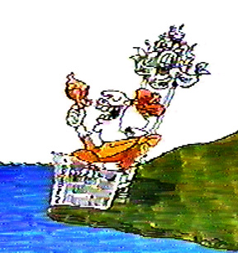
Problems in the 13 Colonies: The British Parliament made decisions!
Britain was taxing the colonies without representation
The colonists felt as if they were being exploited and ignored. (No More King!)
There were harsh British laws against the colonists.
REMEMBER THESE? Stamp Act, Sugar Act, Intolerable Acts

Slide 8
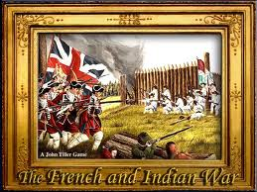
The French and Indian War
The French and Indian War/The Seven Years War (1754-1763)
The British defeated the French, who had the help of many Native American tribes.
It was an expensive war and the British made the colonists pay the expense of the war through taxes.

Slide 9
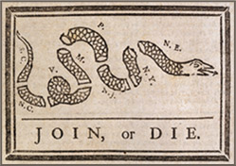
The Albany Plan of Union 1754
Benjamin Franklin demanded that the colonists must unite in their efforts to defeat the British in America.
It called for a joint, colonial council to plan a revolt against the British

Slide 10
The Navigation Acts
A series of laws which restricted the use of foreign shipping in the trade of goods with England and also limited trade.
All goods had to be shipped on English boats and must go through England before hitting the colonies.
It led to the colonists paying higher tariffs for goods.
A tariff is a tax on imported goods to the colonies

Slide 11
The Proclamation Line of 1763
Forbade colonists from settling or buying land west of the Appalachian Mountains.
The colonists were angry because many already had land in that area.
Additionally, the Proclamation gave the British Crown a monopoly in land bought from Native Americans.
A monopoly is when a single person/group has complete control over a market to purchase a good or service

