Slide 1
Sections 5 and 6: Key Ideas Life in the New Nation

Slide 2
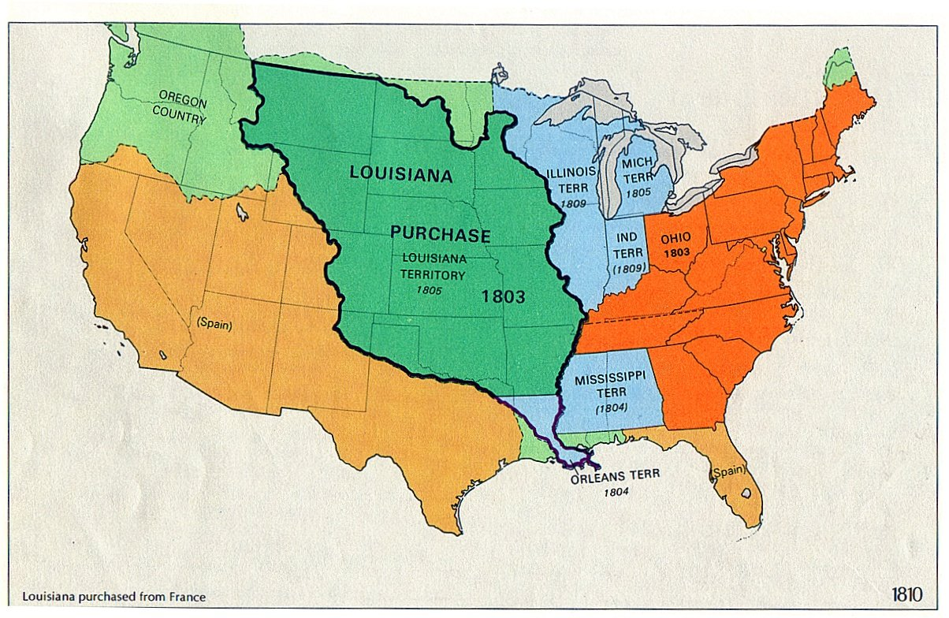
Marbury vs. Madison 1803
Established the principle of Judicial Review (the Supreme Court can declare laws unconstitutional)
THE LOUISIANA PURCHASE
Largest land acquisition in American History
Made by Napoleon from France
Encompassed portions of 15 current U.S. states and 2 Canadian Provinces

Slide 3
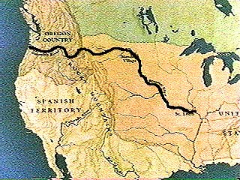
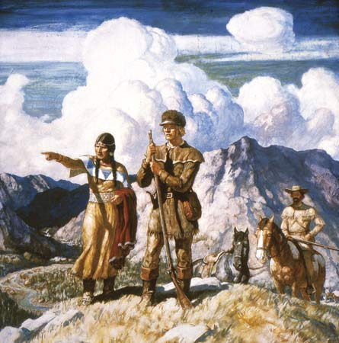
Louis and Clark Expedition 1804-1806
The first American overland expedition to the Pacific coast and back.
Jefferson sent these two men to map out the newly acquired land and discover new areas to the Pacific Ocean.
Led to an intense desire to expand west.

Slide 4
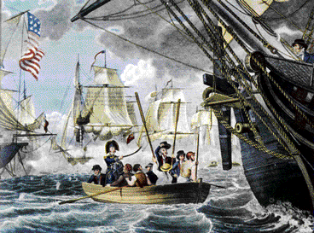
War of 1812
British were mistreating the U.S. Navy and implementing poor trade measures ( impressment of sailors)
The U.S defeated the British
The U.S. felt strong as a nation and became closer to Britain
Francis Scott Key wrote our national anthem “The Star Spangled Banner”

Slide 5
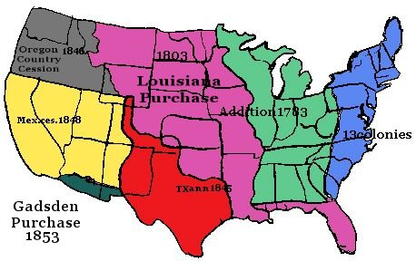
Manifest Destiny 1815-1890
The idea that it is the duty of the U.S. to expand from the Atlantic to the Pacific.
Led to the acquisition of many territories and future states west of the Mississippi River.

Slide 6
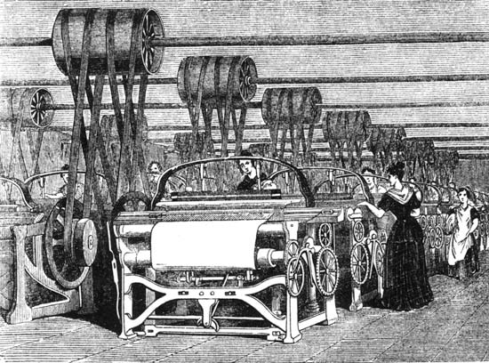
Industrial Revolution
Life became faster and easier for Americans
ELI WHITNEY 1792: The inventor of the cotton gin, which provided a faster method of separating cotton fibers and seedpods.
SAMUEL SLATER: Founder of the American Industrial Revolution; introduced several textile ideas to the various areas in the U.S.

Slide 7
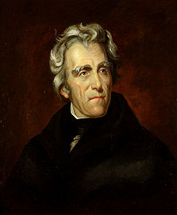
Andrew Jackson
Spoils System: giving jobs to loyal friends or political supporters to expand influence; became controversial.
Indian Removal Act 1830: Jackson’s legislation to move Native Americans to areas west of the Appalachian Mountains
Trail of Tears (1830’s):the forced relocation of Native Americans from their homelands to Indian Territory (present day Oklahoma)

Slide 8
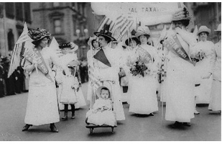
Seneca Falls Convention 1848
Meeting of several women to discuss the idea of women’s rights; began the women’s suffrage movement
Led by Elizabeth Cady Stanton and Susan B. Anthony
Wrote the Declaration of Sentiments, which was modeled after the Declaration of Independence and declared reasons why women should vote

Slide 9
Mexican-American War 1846-1848
An armed military conflict between the United States and Mexico from 1846 to 1848 in the wake of the 1845 U.S. annexation of Texas.
The most important consequence of the war for the United States was the Mexican Cession, in which the Mexican territories of Alta California and Santa Fé de Nuevo México were ceded to the United States under the terms of the Treaty of Guadalupe Hidalgo. The U.S. also kept Texas. Enhanced Manifest Destiny.

Slide 10
The Gold Rush 1848-1855
the discovery of gold in California led many Americans and foreigners to settle out there to seek the potential “fortune.”

