Slide 1
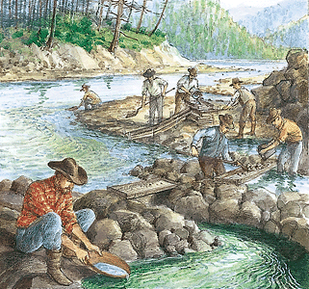
The Gold Rush
1848-1855
the discovery of gold in California led many Americans and foreigners to settle out there to seek the potential “fortune.”

Slide 2
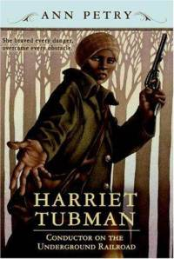
Pre-Civil War
ABOLITIONISTS:
  the people who fought for an end to slavery in the U.S.
    Harriet Tubman: leader of the underground railroad, which tried to help slaves escape to the North or other free areas.
    Harriet Beecher Stowe: author of Uncle Tom’s Cabin, an abolitionist book.

Slide 3
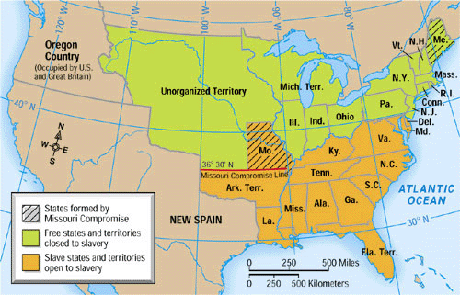
Pre-Civil War
COMPROMISES
Missouri Compromise(1820): prohibited slavery in the former Louisiana Territory north of the parallel 36°30’ except within the boundaries of the proposed state of Missouri.

Slide 4
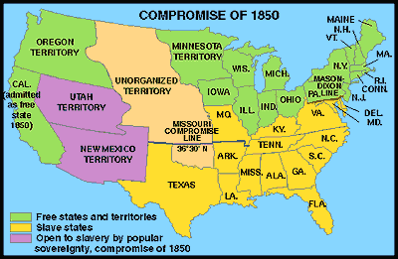
Pre-Civil War
Compromise of 1850: There were 5 laws which balanced the interests of the slave states of the South, Missouri, and the free states to the north.
California was admitted as a free state.
Texas received financial compensation for relinquishing claim to lands west of the Rio Grande in what is now New Mexico.
The territory of New Mexico was organized without any specific prohibition of slavery .
the slave trade (but not slavery itself) was terminated in the District of Columbia.
The stringent Fugitive Slave Law was passed, requiring all U.S. citizens to assist in the return of runaway slaves regardless of the legality of slavery in the specific states.

Slide 5
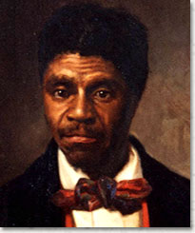
Pre-Civil War
Kansas-Nebraska Act (1854): created the territories of Kansas and Nebraska, opened new lands, repealed the Missouri Compromise of 1820, and allowed the settlers to decide whether or not to have slavery within those territories. (popular sovereignty)
Dred-Scott Decision (1857): declared that slaves were property and were not citizens.

Slide 6
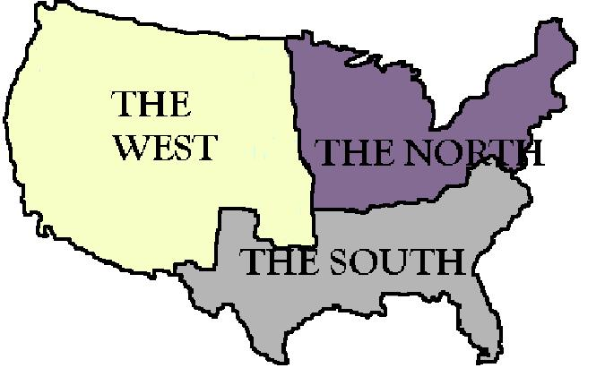
Pre-Civil War
Sectionalism: the division of the U.S. between the North, South, and West; all areas had their own political beliefs and thoughts on slavery.
States Rights: southern states believed that they each had the right to decide on the fate of slavery in their territory.
Election of 1860: Lincoln’s victory led South Carolina to secede from the Union, with several other southern states following its lead. The Confederacy was formed with Jefferson Davis as its leader.
The firing on Fort Sumter started the war in 1861.

Slide 7
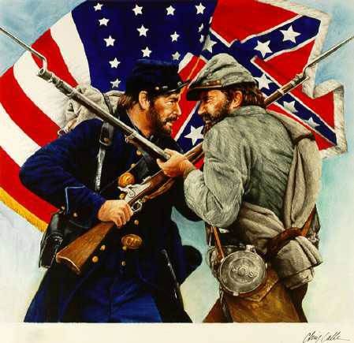
The Civil War
1861-1865
Abraham Lincoln: President of the Union (U.S.); major initial goal was to preserve the Union, not to free the slaves (until the end of the war!)
General Robert E. Lee led the Confederate troops (South); General Ulysses S. Grant led the Union Army (North).
Most of the fighting took place in the South.

Slide 8
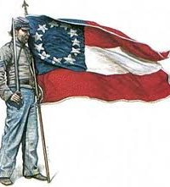
The Civil War
ADVANTAGES/DISADVANTAGES
Southern Advantages: fought a defensive war; better military leaders.
Northern Advantages: larger population; more industrial, better railroads; better equipment; more naval power. (SELF-SUFFICIENT)
AGRICULTURAL SOUTH V. INDUSTRIAL NORTH

Slide 9
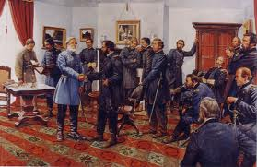
The Civil War: The End
Gettysburg: turning point in the war; the furthest the South got into the North; Union army was victorious.
Emancipation Proclamation(1863): Lincoln’s declaration that all slaves were freed in any state still in rebellion against the Union.
The war ended in 1865; the Union army used total warfare to force General Lee and the Confederacy to surrender.

