Slide 1
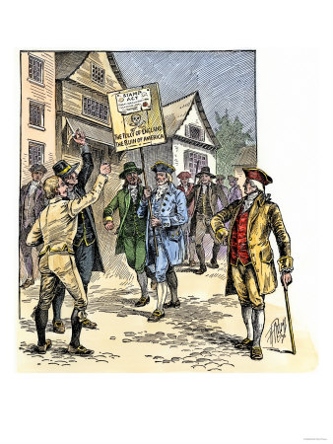
Stamp Act of 1765
The Act required all legal documents, permits, commercial contracts, newspapers, wills, pamphlets and playing cards in the colonies to carry a tax stamp.
It was part of an economic program directly affecting colonial policy that was started to help the British pay their war debts from the French and Indian War.

Slide 2
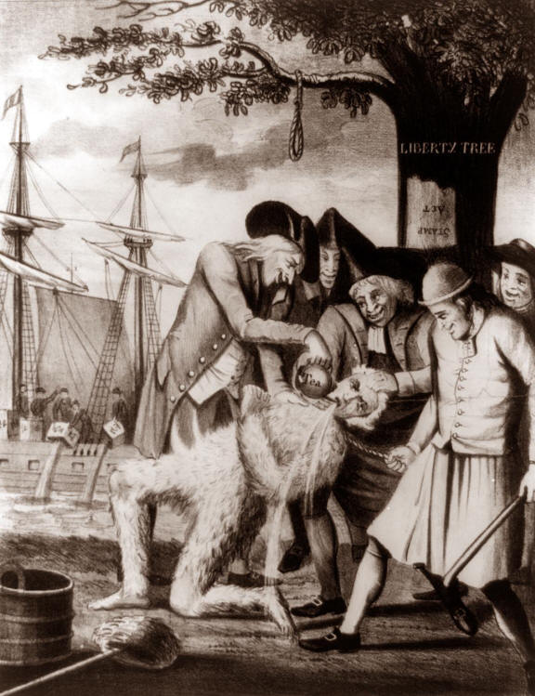
Colonial Boycotts
Many colonists refused to import any British goods right before the Revolutionary War began.
American colonists responded to Parliament’s Acts with organized protest.
Throughout the colonies a network of secret organizations known as the Sons of Liberty were created, aimed at intimidating the stamp agents who collected Parliament’s taxes.

Slide 3
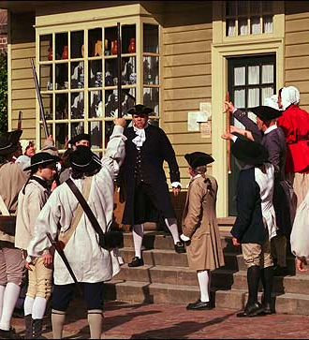
Colonial Boycott: Part 2
Before the Stamp Act could even take effect, all appointed stamp agents in the colonies had resigned.
The Stamp Act Congress passed a “Declaration of Rights and Grievances”, which claimed that American colonists were equal to all other British citizens, protested taxation without representation, and stated that , without colonial representation in Parliament, Parliament could not tax the colonists.

Slide 4
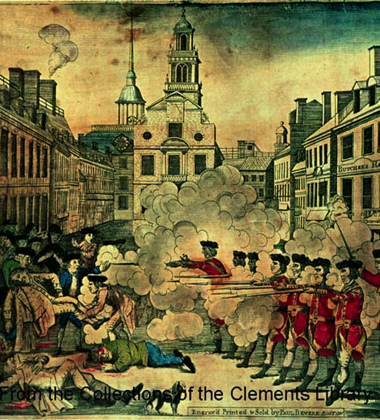
Boston Massacre 1770
The arrival of troops in Boston provoked conflict between citizens and soldiers.
On March 5, a group of soldiers surrounded by an unfriendly crowd opened fire, killing 3 Americans and fatally wounding 2 more.
A violent uprising was avoided only with the withdrawl of troops to islands in the harbor.
The soldiers were tried for murder, but convicted only of lesser crimes
This was noted by patriot John Adams, who was their lawyer.

Slide 5
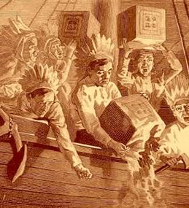
Tea Act/Boston Tea Party
When British tea ships arrived in Boston Harbor, many citizens wanted the tea sent back to England without payment of any taxes.
The royal governor insisted on payment of all taxes.
On December 16, a group of men disguised as Indians boarded the ships and dumped the tea into the harbor

Slide 6
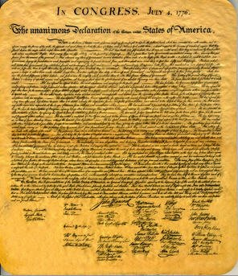
Declaration of Independence
July 4, 1776
Declared reasons for American independence from Britain and showed the colonies were united.
Thomas Jefferson was a major author.
Stated that “all men are created equal”.
States that a nation can revolt against its government if their natural rights of “Life. Liberty and the pursuit of Happiness” are being denied.

Slide 7
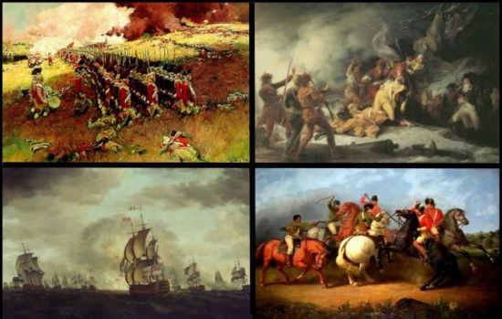
American Revolution (1775-1783)
First shots were fired at Lexington and Concord.
George Washington was the colonial commander-in-chief.
The Patriots were colonists who wanted to break away and the Loyalists were the colonists who remained loyal to the British crown.
The Battle of Saratoga: the war’s turning point with a colonial victory
France and the 13 colonies became allies against the British

Slide 8
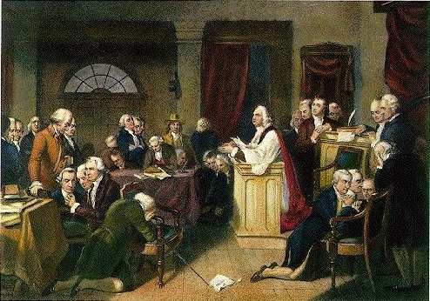
First and Second Continental Congress
Twelve of the thirteen colonies sent a total of 56 delegates to the First Continental Congress.
Only Georgia was not represented.
One accomplishment of the Congress was the Association of 1774, which urged all colonists to avoid British goods, and to form committees to enforce this ban.
The Second Continental Congress convened in Philadelphia on May 10,1774.
John Hancock was elected president of Congress

Slide 9
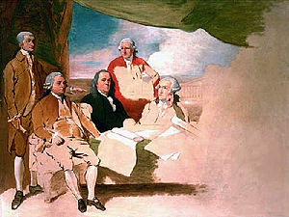
Treaty of Paris 1783
Ended the American Revolution.
Its terms called for Great Britain to recognize American independence and provide for the evacuation of British troops.
Great Britain also gave up its territory between the Mississippi River and the Alleghany Mountains, doubling the size of the new nation.

Slide 10
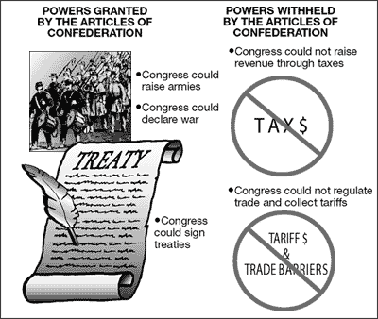
Articles of Confederation 1781
First governing constitution in the U.S.
Gave too much power to the states
Lacked a strong central government with an executive branch
Congress was in control
** States still had too much power for this first government to work!

