Slide 1
American Revolution (1775-1783)
First shots were fired at Lexington and Concord.
George Washington was the colonial commander-in-chief.
The Patriots were colonists who wanted to break away and the Loyalists were the colonists who remained loyal to the British crown.
The Battle of Saratoga: the war’s turning point with a colonial victory
France and the 13 colonies became allies against the British

Slide 2
First and Second Continental Congress
Twelve of the thirteen colonies sent a total of 56 delegates to the First Continental Congress.
Only Georgia was not represented.
One accomplishment of the Congress was the Association of 1774, which urged all colonists to avoid British goods, and to form committees to enforce this ban.
The Second Continental Congress convened in Philadelphia on May 10,1774.
John Hancock was elected president of Congress

Slide 3
Treaty of Paris 1783
Ended the American Revolution.
Its terms called for Great Britain to recognize American independence and provide for the evacuation of British troops.
Great Britain also gave up its territory between the Mississippi River and the Alleghany Mountains, doubling the size of the new nation.

Slide 4
Articles of Confederation 1781
First governing constitution in the U.S.
Gave too much power to the states
Lacked a strong central government with an executive branch
Congress was in control
** States still had too much power for this first government to work!

Slide 5
Federalists vs. Anti-Federalitsts
Federalists: support separation of powers within a strong central government
Anti-Federalists: believed in a bill of rights with more power to the state governments. Against very strong central government.

Slide 6
Constitutional Convention 1787/U.S. Constitution 1788
Democracy: Power comes from the consent of the governed
Federalism: The system in which the power to govern is shared between the national and state governments.
States Rights: powers given to the states that are not held by the federal government

Slide 7
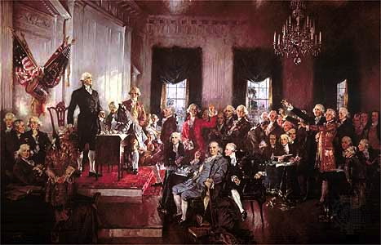
Constitutional Convention 1787/U.S. Constitution 1788
PART 2
Separation of Powers: each branch of government has specific roles.
Checks and Balances: prevents one branch from abusing its power.
Amendments/Elastic Clause: ability to change the constitution with the changing times

Slide 8
Constitutional Convention 1787/COMPROMISES and BILLS
3/5TH’s Compromise: Three-fifiths of the population of slaves would be counted regarding both the distribution of taxes and the apportionment of the members of the U.S. House of Representatives
Great Compromise: created two house legislature with Congress and the House of Representatives.
Bill of Rights: first ten amendments to the Constitution; protect individual rights. This was added to make states and the states and anti-federalists happy.

Slide 9
New York State Government vs U.S. Federal Government
Electoral College: Made of 538 electors/representatives who select the president and vice-president every 4 years.
Executive Branch: NY Governor/U.S. President
Legislative Branch: NY State Assembly(state senators and assemblymen)/ U.S. Congress (House and Senate)
Judicial Branch: NY State Supreme Court/ Federal U.S. Supreme Court

