Slide 1
Do Now:
1.Take out your HW- Victory and Freedom
2. Use the paper handed to you at the door to create a tri-fold (fold in thirds-see the side board for an example)
Homework-
Study test tomorrow on the American Revolution

Slide 2
Agenda:
Create a quick review guide of what you know. 5 mins. ONLY!
Go over the HW/ hand back papers/notebook check.
Game time review.
Study guide/handout.

Slide 3
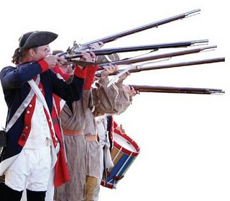
Social Studies: American Revolution Review
You may use your note guide, you created.

Slide 4
Name 3 causes of the American Revolution.
Taxes placed on the colonists following the French and Indian War (“No taxation without representation”) ex. Stamp Act, Sugar Act, Townshend Acts.
Proclamation of 1763- England would not allow colonists to settle in the area west of the Appalachian Mountains.
Intolerable Acts- meant to punish the colonists after the Boston Tea Party. Closed the port in Boston, no more town meetings without permission, major crimes had to be tried in England, and colonists had to house redcoats.

Slide 5
What is mercantilism?
Economics theory that states that a nation’s power comes from gold supplies and trade.

Slide 6
How did England use the colonies to promote their own mercantilism?
Limited the colonies’ trading with other nations. (Navigation Acts)

Slide 7
Describe the difference between a Patriot and a Loyalist.
Patriot- colonist rebel against British/English rule. Want independence.
Loyalist- loyal to “Mother England.” fought on the British side.

Slide 8
*BONUS*: Name one similarity between Loyalists and Patriots.
Both were colonists

Slide 9
Name one advantage the British had over the American colonists and one advantage the colonists had over the British.
British- better army, trained soldiers, more money/supplies, more food, better living conditions
American colonists- motivation, passion for freedom, knew the land better

Slide 10
Explain “The Shot Heard Around the World.”
The first shots starting the revolution were fired at Lexington, Massachusetts.
When the British soldiers reached Lexington, Captain Jonas Parker and 75 armed Minutemen were there to meet them. The Minutemen were greatly outnumbered. The British soldiers fired, killing 8 Minutemen and injuring 10 others.
On April 18, 1775, British General Thomas Gage sent 700 soldiers to destroy guns and ammunition the colonists had stored in the town of Concord, just outside of Boston.
Although Paul Revere was captured by British scouts before reaching Concord, other messengers managed to get through and warn the people. While the British soldiers continued on their way to Concord, the men and women of Concord were busy moving the arms and ammunition to new hiding places in surrounding towns. When the soldiers arrived they were only able to destroy part of the supplies.

Slide 11
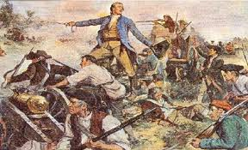
Define the term militia.
Army of ordinary, untrained citizens who provide defense in emergency or a moment’s notice. (minutemen)

Slide 12
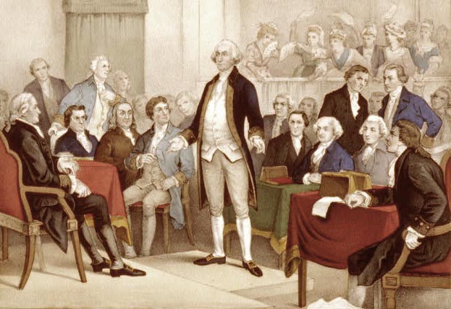
*BONUS*- What was the name of the colonial governing body, during the war.
Continental Congress

Slide 13
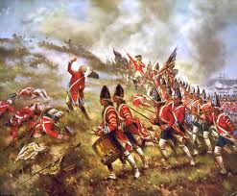
Explain why Bunker Hill was still a victory for the colonists, even though the British gained control of the hill.
The British suffered a loss of over 1,ooo and wounded. Nearly half of the force engaged.
The American casualties were estimated at 450 killed and wounded.

Slide 14
Why were the battles of Trenton and Princeton significant for the Americans?
Proved that the colonists should not be underestimated.
Victory provided the morale boost and confidence needed by the colonists.

Slide 15
Why might other nations be willing to help the American colonists?
They wanted to gain power over England and were in competition with England.

Slide 16
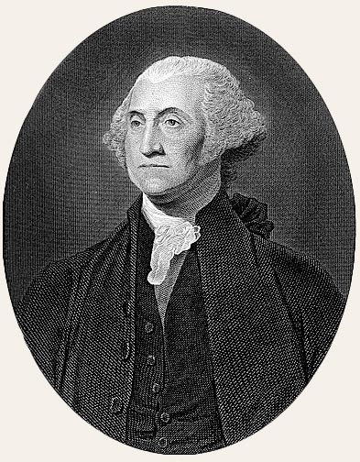
*BONUS*- Who was the leader of the Continental Army?
George Washington

Slide 17
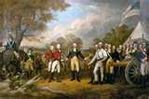
What happened as a result of the Battle of Saratoga?
American colonists proved they could possibly win the war.
The French agreed to join- providing supplies and assistance.

Slide 18
What united the colonists during the revolution?
Their passion for independence/freedom from British rule.

Slide 19
What was considered the last major battle of the Revolutionary war?
Yorktown, Virginia

Slide 20
Who was the victor of the battle of Yorktown and how was victory obtained?
American colonists.
George Washington and his army met up with French forces and the French Army.
Cornwallis (British general) was trapped.

Slide 21
What finally ended the war in 1783?
Signing of the Treaty of Paris

Slide 22
What were two outcomes of the Treaty of Paris?
England recognized the independence of the United States.
Colonists now had control of the area west of the Appalachian mountains

Slide 23
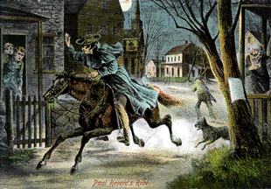
*BONUS* Name and describe the following event.
Paul Revere’s Midnight Ride-
Paul Revere and William Dawes make midnight ride to warn Minutemen of approaching British soldiers

Slide 24
In which colonies, did majority of the concluding battles take place?
-Southern colonies

Slide 25
Additional Notes/Summary: Use your study guide to create a summary as you review. Good luck.

