Slide 1
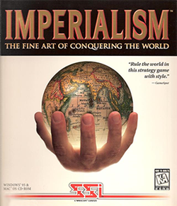
Welcome to the international Arena

Slide 2
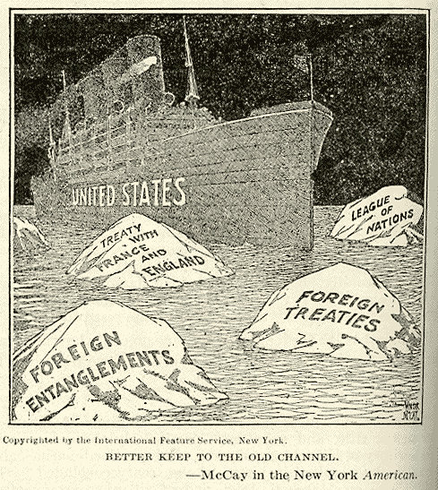

Slide 3
What is Imperialism?
A policy of powerful countries that seek to control the political and economic affairs of weaker countries or regions

Slide 4
What is Isolationism?
A policy of having little to do with foreign affairs or nations. A nation will ultimately decide to remain “isolated” from contact with foreign nations, with the exception of business relationships.

Slide 5
Why did the policy of isolation suit most americans in the 1800’s?
Americans were busy focused on issues here at home – industrialization, building up the economy, reform and equality.

Slide 6
“There must be two Americans. One that sets captives free and one that takes captive’s new freedom away.” -Mark twain, author

Slide 7
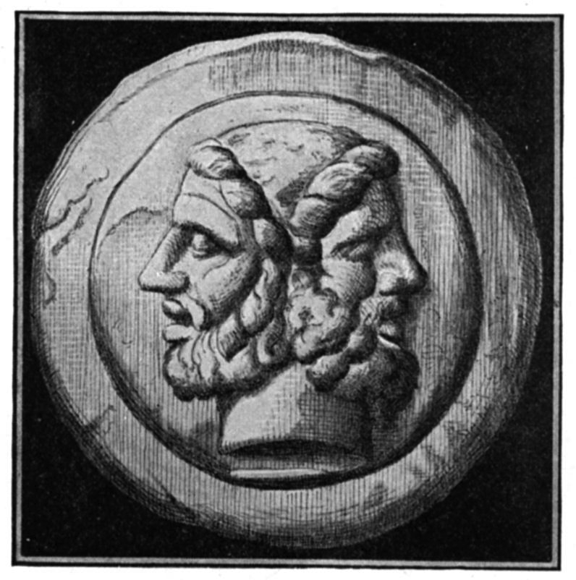
The US has “ multiple personalities”
Roman God Janus – Two Faces
One looks to the past, the other to the future
Everyone has a good side and a bad side
Giver of the beginning/decider of the end
“Three Faces of Eve” (1957)
US has “multiple personalities” disorder –
We are the “giver” if freedom in one sense and
the taker of that newly given freedom in another.

Slide 8
Sphere of influence
Areas where countries had exclusive rights to trade, invest and had special political rights

Slide 9
Open Door Policy
Imperialist – helpe US businesses by guarenteeing equal trading rights for all (preventing discrimination)
Anti-imperialist – China maintained its own territorial integrity (no one foreign power was going to claim ownership of it)
PROBLEM- China did not approve it; there was no real way to enforce

Slide 10
Fists of righteous harmony
Secret society that wanted to rid China of foreigners & throw off the “yolk” of the corrupt Chinese government.
Often called “Boxers” because they practiced martial arts.

Slide 11
Boxer Rebellion June 1900
Bloody campaign
Murdered 1,000’s of foreign missionaries & Chinese Christian converts
8-1)Relief troops arrived from Britain, France, Germany, Japan and the US to help squash the rebellion.
8-2) Boxers believed that they were impervious to enemy bullets from meditation and discipline and could not be harmed. 1000’s were killed.

Slide 12
Boxer Rebellion June 1900
9) Rebellion ended with a treaty

Slide 13
3 vastly different philosophies
3 Presidents, 3 very different ideas on how to deal with foreign powers
Big Stick Policy – Theodore Roosevelt
Dollar Diplomacy –William Howard Taft
Moral Diplomacy – Woodrow Wilson

Slide 14
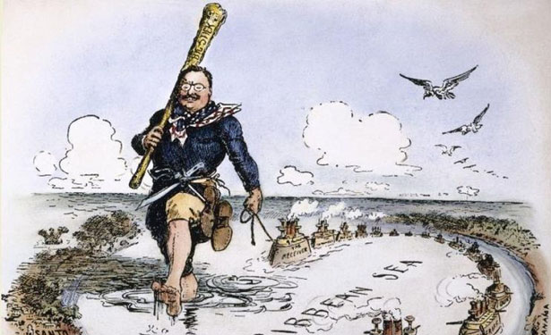

Slide 15
“Speak softly and carry a big stick”
Back up your words with powerful action!
EX: Believed the US should take a strong role in Asia
Examples:
1905- Gentlemen’s Agreement- ended war between Japan and Russia
1908-1914- Built Panama Canal

Slide 16
“great white fleet”
Show of growing US naval power & might
Tour was triumph, Us regarded as most potent naval power after British

Slide 17
“monroe doctrine 1823”
Sought to limit European expansion into Western Hemisphere

Slide 18
monroe doctrine’s Extension
6a) Roosevelt’s extension of that was called the Roosevelt Corollary
6b) US the right to send our military to Keep powers out of Western Hemisphere

Slide 19
Dollar Diplomacy
Dollar Diplomacy- encouraging US investment in Latin America and China to discourage European investment
RESULT- US owned businesses came to dominate the economies of many small nations in Central America, Caribbean and parts of South America

Slide 20
Moral Diplomacy
Moral Diplomacy- applying a moral standard by not recognizing any gov’t that is undemocratic or hostile to the interests of the US.
RESULT- Failed with Mexico ( war was barely averted, President was assassinated)

Slide 21
Student analysis
OVERSEAS EXPANSION GROUPWORK:
1) Examine quotation
2) What does the word embroiled mean? 3) Brief statement describing the author’s meaning of the quotation.
4) Based on your newly acquired knowledge, cite one piece of evidence that supports your group’s opinion

