Slide 1
Chapter 13 Changes on the Western Frontier
Native American Culture in Crisis
The Growth of the Cattle Industry
Settling on the Great Plains
Farmers & the Populist Movement

Slide 2
Native American Culture in Crisis
“Between the 1850s & 1890, settlers flocked to the West in search of gold or land. In the process, they nearly destroyed the traditional culture of Native Americans living on the Great Plains. Competition for land often led to bloody conflict…”
-Unknown

Slide 3
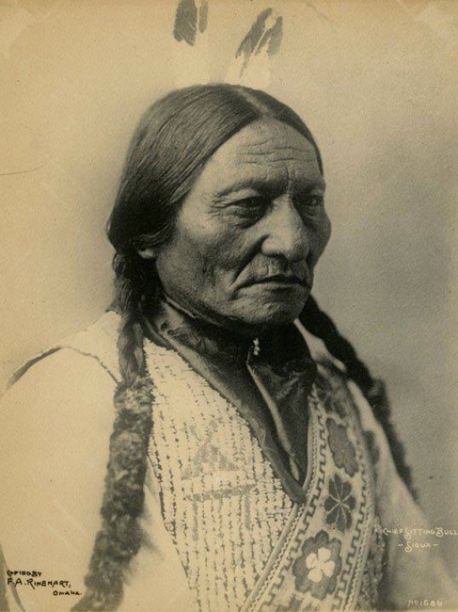
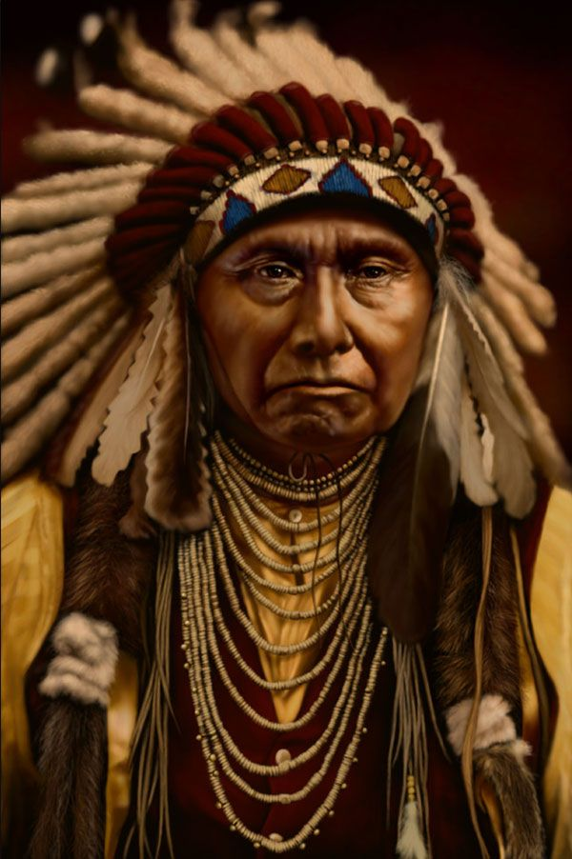
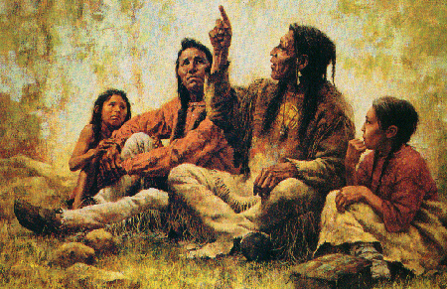
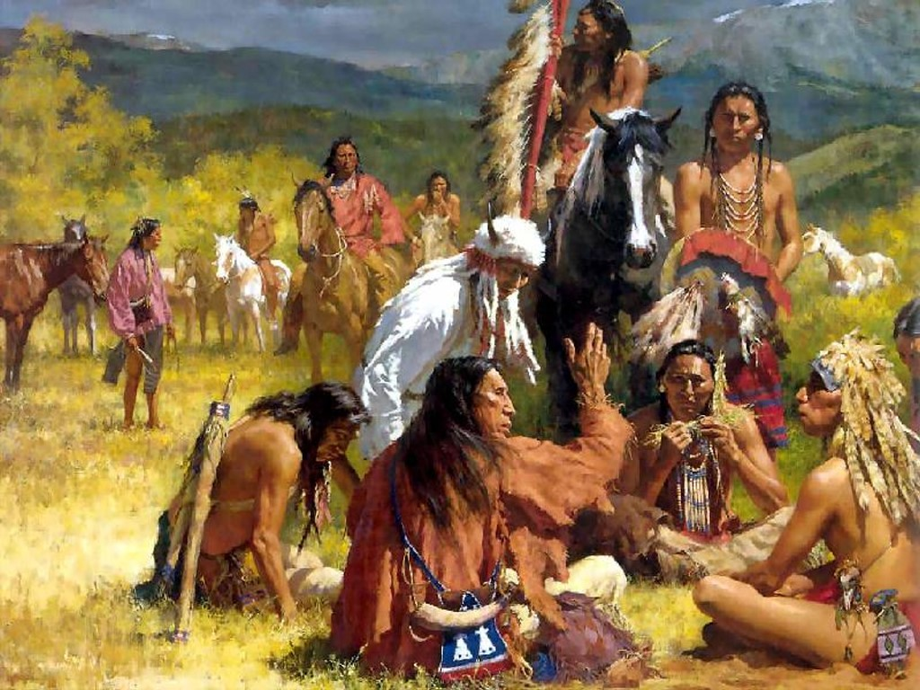
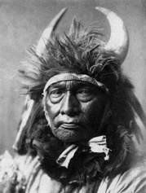
Important to Note…

Slide 4
They are NATIVE AMERICANS/NATIVES.
Or
They are American Indians.
For 250+ years we have often simply referred to these indigenous peoples as Indians, yet we need to understand that that they are identified as American Indians .
-Courtesy of “Indian Education Act of 1972”

Slide 5
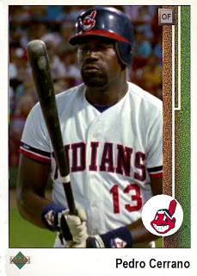
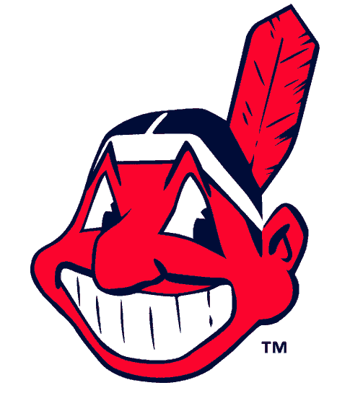
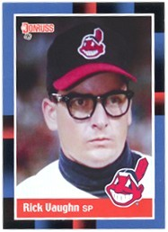
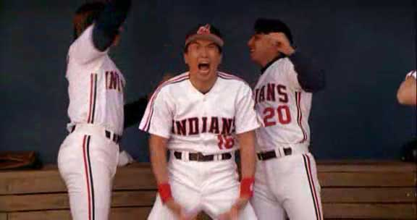
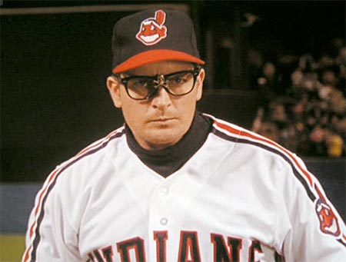
These Are The Indians
First of many sports references in this chapter….
Pedro Cerrano & Wild Thing. Best ballplayers. Ever.

Slide 6
The Great Plains
Colorado, Kansas, Montana, Nebraska, New Mexico, North Dakota
Oklahoma, South Dakota, Texas, and Wyoming

Slide 7
The Great Plains

Slide 8
The State of America at the Time…
“America was big, and the further you got into America the bigger it became, both landscapes and the natural wonders and artifacts.”
-Paul Johnson A History of the American People
Why expand westward into the ”American Heartland” ?
Land.
Agriculture.
Railroads.
Industry.
Gold.

Slide 9
The State of America at the Time…
Population By Year
By 1860, America & its people were growing faster than any country.
Life expectancy grew & infant mortality dropped.
1865: 39,818,449
1880: 50 million +
1890: 62,847,714 (More than any European nation except Russia.)
1900: 75 million +
1914: 100 million +

Slide 10
The State of America at the Time…
Natural increase was aided by mass-immigration.
1815 to 1865: Over 5 million
From Europe (50% English, 40% Irish).
1865 to 1890: Over 10 million
From Great Britain, Germany, Scandinavia.
1890 to 1914: Over 15 million
From Eastern & Southern Europe.
From 1910 to 1914: Immigration average? One million per year.
America was becoming overcrowded.
Where are these people to go? West.

Slide 11
Settlers Explore the Frontier
Clash of culture ensued when settlers came in contact with Natives.
Settlers determined the land had been forfeited since Natives did nothing to improve it.
Homestead Act of 1862
Granted 160 acres of federal land, must be cultivated for five years.
10% of the United States will be given away.

Slide 12
Homestead Act of 1862
“Never in human history, before or since, has authority gone to such lengths to help the common people become landowners.”
Land was not suitable to familiar methods of farming.
Farmers dug into water tables & developed drought resistant strains of grain.
Exodusters: African-Americans who moved from the South to Kansas following Reconstruction in a great “exodus”.

Slide 13
Transcontinental Railroad
Transcontinental: expansion across the continent
1862: Pacific Railroad Act is passed giving federal lands to Union Pacific and Central Pacific to construct the first transcontinental railroad.
Union Pacific: Missouri River, through the Great Plains, to the Rocky Mountains
Central Pacific: Sacramento through the Sierra Nevada

Slide 14
Transcontinental Railroad
Met at Promontory Summit, Utah, on May 10th, 1869

Slide 15
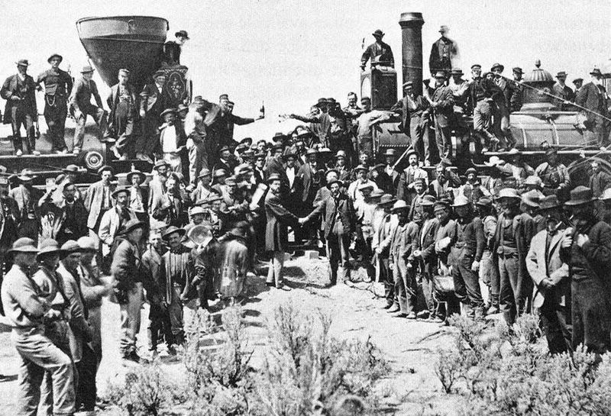
Transcontinental Railroad
The Central Pacific's engine Jupiter and the Union Pacific's engine No. 119 meet on May 10, 1869, at Promontory Summit, Utah.

Slide 16
Transcontinental Railroad
Central Pacific Railroad Company
Union Pacific Railroad Company
3,000 Irish workers
10,000 Chinese workers
Irish Civil War veterans
Hundreds would die due to inclement weather,
occupational hazards, or Native attacks.
The human cost was extravagant:
In 1889, the Interstate Commerce Commission shows
that more than 22,000 workers were killed or injured.
Both companies would lay as much track as possible
to raise profits.
Union Pacific had built 1,086 miles of track
Central Pacific had built 689 miles of track

Slide 17
Native Relations
Nonintercourse Act of 1834: Set aside the Great Plains as one large reservation. Stated that no white person could enter Native country without a license.
1851: Due to excitement from the gold rush, Treaty of Fort Laramie is signed.
Peace follows for a short while. In time this would bring a clash with settlers.

Slide 18
Geographical Circumstances & Significance
Key Point: Is this Manifest Destiny being fulfilled, or people being denied their
homelands?
Key Point: Are they brutes or simply the victims of a nation with great hopes?

Slide 19
Plains Indian(Native)Wars
Roughly from the 1860s – 1880s.
“Uprisings” brought on by hostile tribes of the Great Plains horse and buffalo cultures.
Subdued by buffalo extermination and campaigns by the US military.

Slide 20
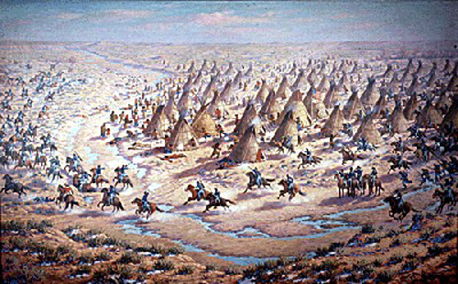
Massacre at Sand Creek in 1864

Slide 21
Massacre at Sand Creek 1864
The Cheyenne raided trails off their reserve for supplies.
Colorado Gov. orders the militia to suppress the “raiders”.
Those who do not wish to fight were to report to a fort where they would be safe.
Colonel John Chivington led an attack on the fort, by order, in which he killed 70 – 200 Cheyenne. Most women & children.

Slide 22
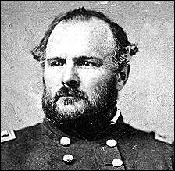
The Cheyenne & The Colorado Territory Militia
Cheyenne Tribe Flag
Col. John Chivington

Slide 23
Things to remember while reading the testimony of John S. Smith:
Black Kettle, the leader of the Indians massacred at Sand Creek, wanted to cooperate with white authorities and raised a white flag to signal his peaceful intentions to Chivington's forces.
Chivington's defenders insist that he had evidence that proved that Black Kettle's Cheyenne tribe was involved in warfare against whites, and that the Cheyenne fought back quite fiercely against Chivington's attack. Chivington's critics insist that Black Kettle's people were completely peaceful and were mercilessly slaughtered.
John S. Smith was an Indian agent and an interpreter who had been sent out to Black Kettle's camp to find out how many people were in the camp and to get a sense of the Indians' attitudes toward whites.
Two examiners, Mr. Gooch and Mr. Buckalew, are questioning Smith.

Slide 24
A Congressional Testimony (1865)
“I saw the bodies of those lying there cut all to pieces, worse mutilated than any I ever saw
before; the women cut all to pieces ...
With knives; scalped; their brains knocked out;
children two or three months old; all ages lying there, from sucking infants up to warriors ... .”
-John S. Smith, eye witness to Sand Creek Massacre 1864
Key Points Question: What bias, if any exists in the testimony above? And By whom were they mutilated and to what point and purpose?

Slide 25
Fetterman Massacre on Bozeman Trail
The Sioux were bothered by settlements established on the Bozeman Trail (Wyoming).
When requests from the tribes went unanswered, the Sioux and other tribes began attacks.
Cpt. William J. Fetterman and his company troops were ambushed and around 80 were killed.

Slide 26
Aftermath of the Fetterman Massacre
Skirmishes continued (1866 – 1868)
Sioux (forced to) signed the Treaty of 1868
Agreed to live along the Missouri River reservation in return for support from the govt.

Slide 27
Arguing Assimilation
FACT: Treaties rarely did much to stop the fighting or conflict between settlers & Natives.
“[We] have been taught to hunt and live on the game. You tell us that we must learn to farm… and take on your ways. Suppose the people living beyond the great sea should come and tell you that you must stop farming… kill your cattle… what would you do? Would you not fight them?”
-Gall Pizi, American Indian leader of the Hunkpapa Lakota in the long war against the United States; A commanders in the Battle of Little Bighorn.
Key Points Question: Give one reason how historical circumstances affected the development of Gall’s argument against assimilation of the American Indians, according to the above excerpt.

Slide 28
Conflict with the Kiowa & Comanche
In the Southern Plains, two tribes refused to move to reservations.
Thus began a raiding spree (lasted 6yrs.) that would lead to the Red River War (1874-1875)
To fight the resistance, the US Army often massacred tribesmen to crush moral and their will to fight.
Strategy was to deny the Natives any safe haven through constant attack. This included wiping out buffalo.

Slide 29
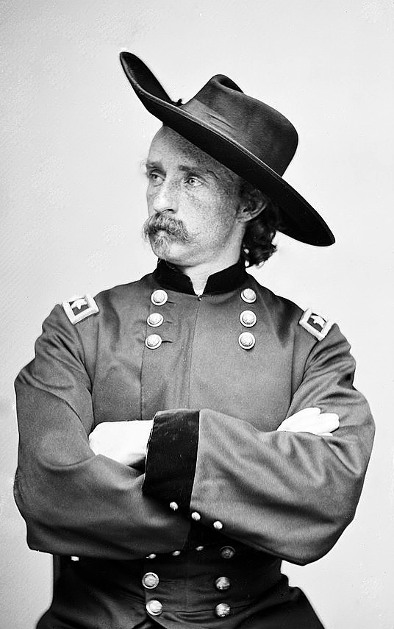
Custer & His Last Stand
Causes – Gold Rush, Settlers, Culture Clash
Result – Custer’s Last Stand
After a Sioux victory at Rosebud Creek (Montana), their next challenge was Custer. Seeking fame & absolute victory, Custer rode against 2,000 – 3,000 Native warriors…
With 200 men.
The battle lasted less than half an hour.
All US troops were killed.
Aftermath – US citizens want revenge.
Sitting Bull retreats to Canada.

Slide 30
Dawes Act (1887) & Assimilation
Dawes Act
Assimilate Natives into American culture.
How?
Privatize land through property ownership by family rather than tribe.
Any land left over would be sold to settlers.

Slide 31
An (Un)American Perspective?
Native speaker offered that “We know that you highly esteem the kind of learning taught in those colleges, and that the maintenance of our young men, while with you, would be very expensive to you. We are convinced, therefore, that you mean to do us good by your proposal, and we thank you heartily. But you who are wise must know that different nations have different conceptions of things; and you will therefore not take it amiss if our ideas of this kind of education happen not to be the same with yours. We have had some experience of it: several of our young people were formerly brought up at the colleges of the northern provinces; they were instructed in all your sciences; but when they came back to us, they were bad runners; ignorant of every means of living in the woods; unable to bear either cold or hunger; knew neither how to build a cabin, take a deer, or kill an enemy; spoke our language imperfectly; were therefore neither fit for hunters, warriors, or counsellors; they were totally good for nothing. We are, however, not the less obliged by your kind offer, though we decline in accepting it: and to show our grateful sense of it, if the gentlemen of Virginia will send us a dozen of their sons, we will take great care of their education, instruct them in all we know, and make men of them.”
Benjamin Franklin
Benjamin Franklin Papers 1782-1783
Key Points Question: Give one reason how historical circumstances affected the development of Franklin’s argument in favor of assimilation of the American Indians, according to the above excerpt.
*How could Franklin’s point of view possibly been biased? Give one reason.

Slide 32
Wounded Knee: The Last “Battle”
Sitting Bull was killed prior to in an incident:
Seeking his arrest, a personal body guard fired and killed
a policeman. The police open fired killing Sitting Bull.
7th Calvary
Sioux Tribes
20 – 45 killed
300 – 400 killed
(most women & children)
Soldiers rounded up 350 Sioux and brought them
to Wounded Knee Creek. A shot was fired by accident
leading the military to open fire on the camp.
Most in the camp were unarmed.

Slide 33
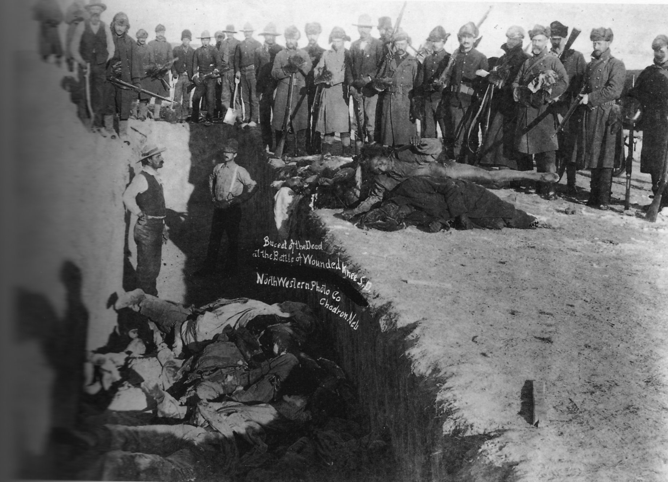

Slide 34
STOP! Chapter 13 REVIEW!

Slide 35
Review!
Describe the Great Plains. What are some states it covers? What is the land like?
The “heart” of America. Stretches from Texas to Montana.

Slide 36
Review!
What are the five reasons for exploring and settling past the Mississippi?
Hint (L.I.A.R. G)
Land
Industry
Agriculture
Railroads
Gold

Slide 37
Review!
What was the main contributing factor that truly forced America to settle the Great Plains?
Growth in population, immigration.

Slide 38
Review!
What was the Homestead Act of 1862?
Gave 160 acres to anyone who could cultivate the land for five years.
Largest land giveaway in the history of the world. 10% of the US would be given away.

Slide 39
Review!
What were “exodusters”?
African-Americans who left the Post-Reconstruction south for Kanas in a mass “exodus”.

Slide 40
Review!
Describe the Transcontinental Railroad. What were the two companies that were hired to complete the task? Where did the two rails meet?
Union & Central Pacific. Met in Promontory Summit, UT.

Slide 41
Review!
Describe the kind of workers that Union Pacific and Central Pacific hired to complete the work.
Mostly Chinese & Irish. Many Civil War veterans were also hired.

Slide 42
Review!
What were the two treaties signed before the Civil War in regards to Native American relations?
Nonintercourse Act of 1834 & Treaty of Fort Laramie (1851)

Slide 43
Review!
What were some of the main events in the Plains Indian Wars?
Massacre at Sand Creek, Fetterman Massacre, Treaty of 1868, Custer’s Last Stand, Dawes Act, Massacre at Wounded Knee

Slide 44
Review!
What was the Dawes Act? What is assimilation?
Dawes Act privatized Native reservations in an attempt to destroy Native culture. Assimilation is the adopting and adapting to of a culture that is different.

Slide 45
The Growth of the Cattle Industry & Settling on the Great Plains
Chapter 13 Sections 2 & 3

Slide 46
The Growth of the Cattle Industry
“As settlers took over the Native American lands, they developed a thriving cattle industry. Learning skills and borrowing… from Mexicans, cowboy herded cattle and shipped them by railroad to growing cities in the east. The cowboy became one of America’s most romantic figures. By the 1880s… droughts, blizzards, and the introduction of barbed wire ended the cattle frontier.”
Key Points Question: Give one reason how geographical circumstances promoted the growth of both the cattle industry and the railroad industry in modern America, according to the above excerpt.
* How did geographical circumstances prevent the thriving cattle industry from continuing to move westward? Give one reason.

Slide 47
Growth of the Cattle Industry
Population By Year
By 1860, America & its people were growing faster than any country.
Life expectancy grew & infant mortality dropped.
1865: 39,818,449
1880: 50 million +
1890: 62,847,714 (More than any European nation except Russia.)
1900: 75 million +
1914: 100 million +

Slide 48
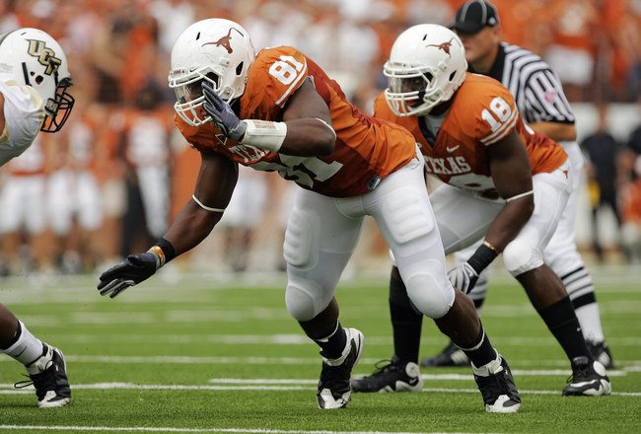
Growth of the Cattle Industry
Sports reference… #4.
The Texas Longhorn
Characterized by their horns (up to 8ft!)
Not native to the United States, they were
introduced by Spanish settlers in the 1500s.
Before railroads, it was hunted and used
primarily for hits hide. After railroads were
built, the Longhorn became noted for its dairy
and beef.

Slide 49
The Transcontinental Railroad, Beef, and YOU!
As settlers took Native Lands, they began to… settle…
Farming
Ranching
Herding

Slide 50
The Cowboy
Known as the “Vaquero” in Mexico, the Cowboy was vital to the growth of the cattle industry.
Before the railroad:
Cattle were slaughtered for their hides
After the railroad:
Cattle could be transported to cities where food was in demand. Air conditioned cars.

Slide 51
Air Conditioned Train Car
"A refrigerator car... arrived in this city yesterday morning laden with 16,000 pounds of beef placed on board at Detroit on Wednesday of last week. This car was in charge of Mr. George H. Hammond on its passage. The ice is placed in narrow chambers at each side of the car, opening only at the top from outside, and does not, therefore, come in contact with the meat or the air in the car which is kept cold and dry. The meat was in better condition than that received directly from our home markets.”
The Boston Daily Advertiser (April 1869)
Key Points Question: Give one reason economical circumstances promoted the growth of the railroad industry in America, according to the above excerpt.

Slide 52
The Cowboy
Cattle Dealer, Joseph McCoy desired to create a shipping yard where the trail would meet the rail.
Abilene, Kansas, would become that city.
From Abilene, cattle could be transported anywhere.
Thus, the Chisholm Trail was born & ran from San Antonio to Abilene.
Lol. #5. Go Giants.

Slide 53
The Cowboy
Lol x 2.
1 in 4 were African-American.
1 in 10 were Mexican.
Often leading herds ranging from 1,000 to 4,000 or more, the Cowboy had a tough job.
Come 1887, lasting just over 20 years, the Cowboy would see its end due to barbed wire and bad weather.
Spring – Round up.
Starve them, brand them, herd them.
The Long Drive.
Could last 3 months or more.
City dwellers glorified the Cowboy for
their life of “adventure”. Sleeping outdoors,
riding horses, confronting Natives (not as
frequent as one may believe.).

Slide 54
Cities and Towns Prosper
Tacoma, Reno, Fresno, Cheyenne, Billings, Albuquerque all grew from the Railroad.
Chicago, St. Louis, Omaha, Sioux City all became major meat-packing centers.
Key Points Question(s): Give one reason how historical circumstances affected the development of the transcontinental railroad, according to the above excerpt.
Further, what geographical circumstances helped to promote western population growth?

Slide 55
Settlers & Farmers
By 1865, there were 20,000 pioneers who had migrated westward.
By 1905, 500,000 more would become Homesteaders.
However, over two million families would buy land from railroad companies, the government, or through other means.

Slide 56
Settlers & Farmers
1884 – Five Transcontinental Railroads

Slide 57
Settlers & Farmers
Farmers in the Great Plains experienced a variation of different hardships:
Floods, fires, droughts, blizzards, locusts, and the threat of Native Americans. The weather was the biggest threat.
Farmers lived in “soddies”.
Women had better opportunity in the Great Plains:
Ratio of men to women was about 100 to 1.
Women worked side by side with men and often owned land or businesses.
#7
Thunder & lightning posed a large threat to both
cowboys & settlers ->

Slide 58
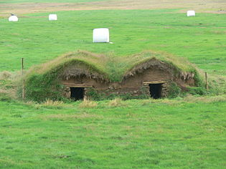
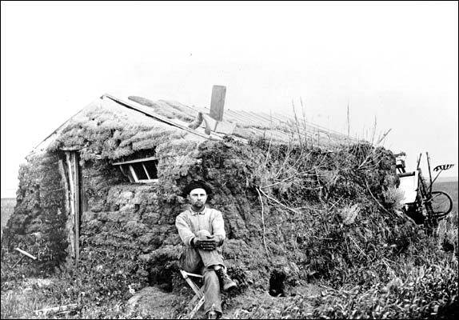
Settlers & Farmers
Inventions by John Deere (Steel Plow in 1837) and Cyrus McCormick (Reaping Machine in 1847), seed drills and barbed wire, made work easier.
However, it would cast many farmers into debt.

Slide 59
Morrill Land Grant Act of 1862
#8
Passed to help support agricultural education by granting federal lands to
states to form agricultural colleges.
The Hatch Act of 1887 built agricultural research stations to make farming
Improvements such as threads of grain that were able to survive in droughts.

Slide 60
STOP! Chapter 13 Sections 2 & 3 REVIEW!

Slide 61
Review!
What were some of the main reasons for the growth of the cattle industry in the USA?
Growing population, transcontinental railroad.

Slide 62
Review!
What was the name of the cattle that we focused on? Where did it come from? Why was it used?
The Texas Longhorn. Brought from Spain in 1500s. Very lean meat, good quality.

Slide 63
Review!
What impact did the Transcontinental Railroad have on settlers and Natives?
The railroad removed Natives from their land opening it up to settlers to farm, herd, or ranch.

Slide 64
Review!
Before the railroad, what were cattle primarily used for? What inventions helped to move cattle across the country?
Killed for hides. The railroad, the Chisholm Trail, and air conditioned cars helped move cattle.

Slide 65
Review!
Who had the idea to make trail meet rail with the Chisholm Trail? Where did it start and meet?
Joseph McCoy. The trail started in San Antonio, Texas and met the rail at Abilene, Kansas.

Slide 66
Review!
Describe the duties of a cowboy. What kind of diversity did cowboys have?
Corralling, herding, branding, etc…
1 in 4 = African-American
1 in 10 = Mexican

Slide 67
Review!
Name some of the cities that grew from the railroad & the cattle drive.
Tacoma, Reno, Fresno, Cheyenne, Billings, Albuquerque all grew from the Railroad.
Chicago, St. Louis, Omaha, Sioux City all became major meat-packing centers.

Slide 68
Review!
By 1884, how many Transcontinental Railroads were there?
Five.

Slide 69
Review!
What were the threats that farmers & settlers experienced on the frontier?
Floods, fires, droughts, blizzards, locusts, and the threat of Native Americans.

Slide 70
Review!
What were living conditions like on the Frontier? How were women treated?
No wood = living in soddies. Women were often treated better than in cities and on coasts.

Slide 71
Review!
What did the Morrill Act of 1862 do? The Hatch Act of 1887?
Morrill Act = Land Grant Colleges (A&M)
Hatch Act = Built agricultural research stations

Slide 72
BONUS REVIEW.
Name all sports teams I used as references from both lessons & note their significance:
Natives & Pedro Cerrano.
Gold Diggers.
Gold Diggers.
MOOOOOO.
Worst football team. Ever.
Derrick Rose/Windy City.
Kevin “Durantula” Durant.
Johnny Football.
Cleveland Indians
San Francisco 49ers
Denver Nuggets
Texas Longhorns
Dallas Cowgirls
Chicago Bulls
Oklahoma City Thunder
Texas A&M

